Slide 1


Slide 2

Cognitive Stimulation Therapy
Why are we here?
- Lets get our minds active and engaged
- Our brains need to keep ‘Exercising’ just like our bodies

Slide 3

Comfort Agreement
Listen to each other
Respect each other
We wont talk about people we meet to others outside the group
Have Fun
Comfort Break – Tea/coffee
Location of Toilets etc

Slide 4

Group Name??

Slide 5


Group Song??

Slide 6

Orientation
Notes:
If you didn’t know, where could you look to find out?

Slide 7

Any News?
Notes:
Any local/regional news? Any personal news/events?

Slide 8
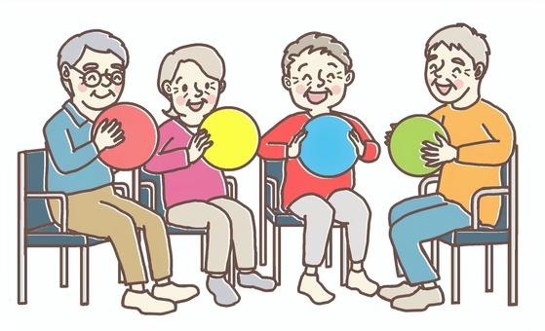
Warm Up Exercises
Notes:
Seated Bowl

Slide 9
This Weeks Theme
Session One – Current Affairs
Refreshment Break
Session Two - Scenes - Ireland

Slide 10
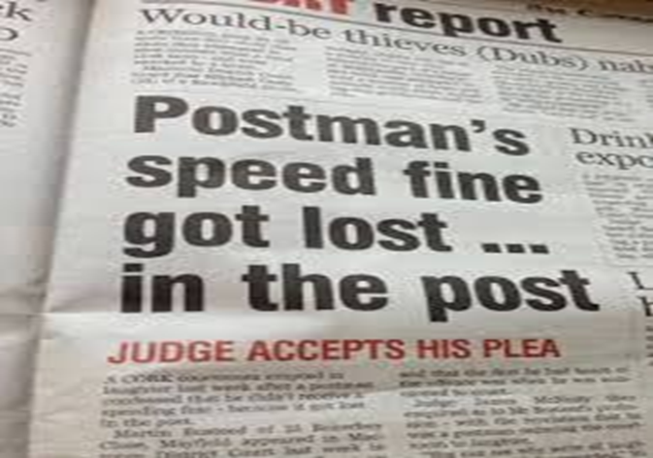
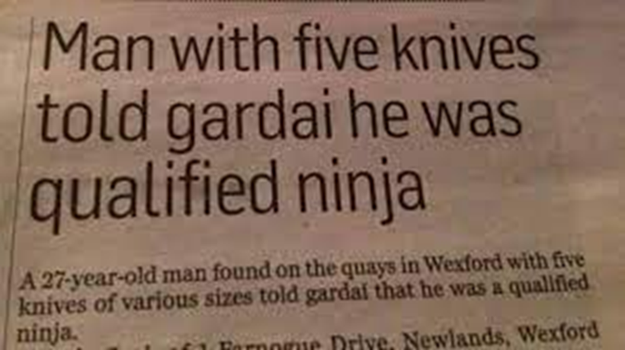

The Headlines

Slide 11
Current Affairs
Where do you like to get your news from ?

Slide 12
Current Affairs
Do you have a favourite newspaper ?
Do you have a favourite news channel on TV?

Slide 13
Current Affairs
Who is your favourite News Reader?
Who is your least favourite News Reader?

Slide 14
Current Affairs
Has anyone heard any unusual stories on the News/Interesting News?

Slide 15
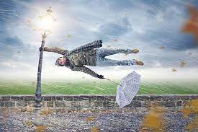
Think of A headline

Slide 16

Think of A headline

Slide 17
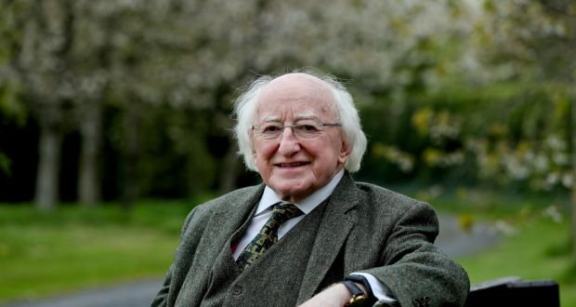

Slide 18


Slide 19


Slide 20


Slide 21
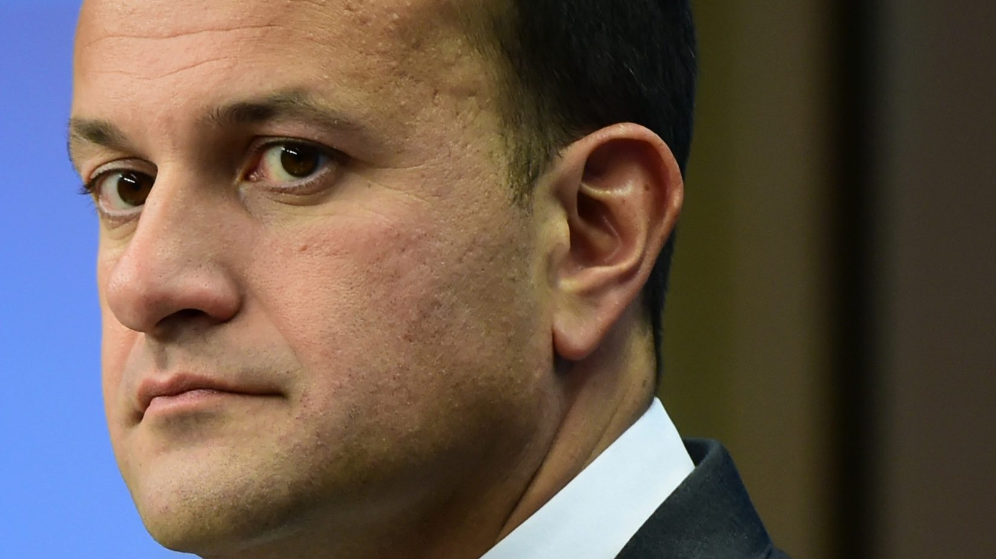

Slide 22
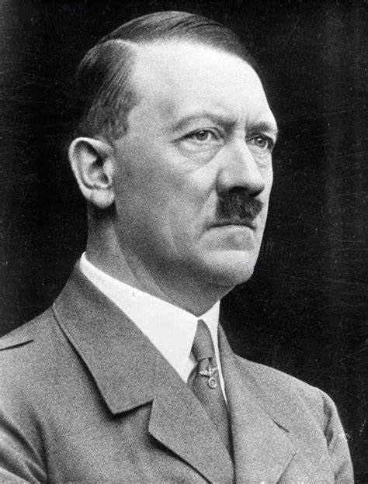

Slide 23


Slide 24
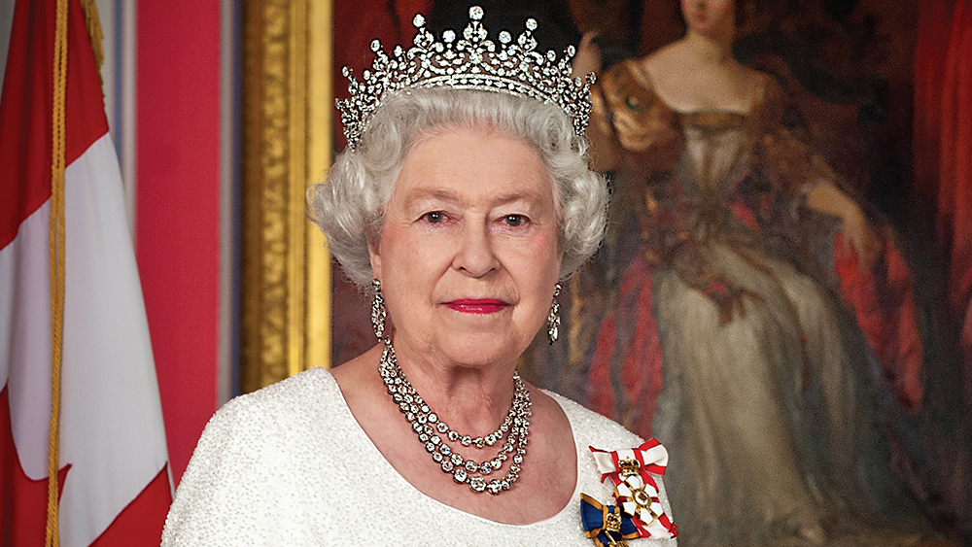

Slide 25
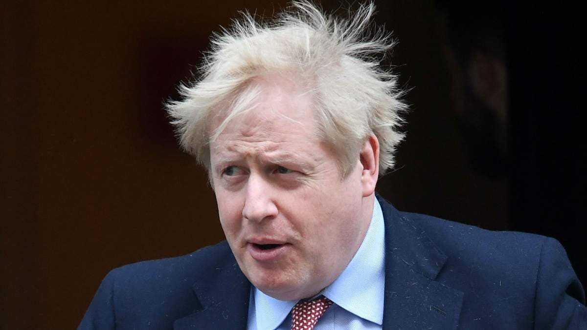

Slide 26
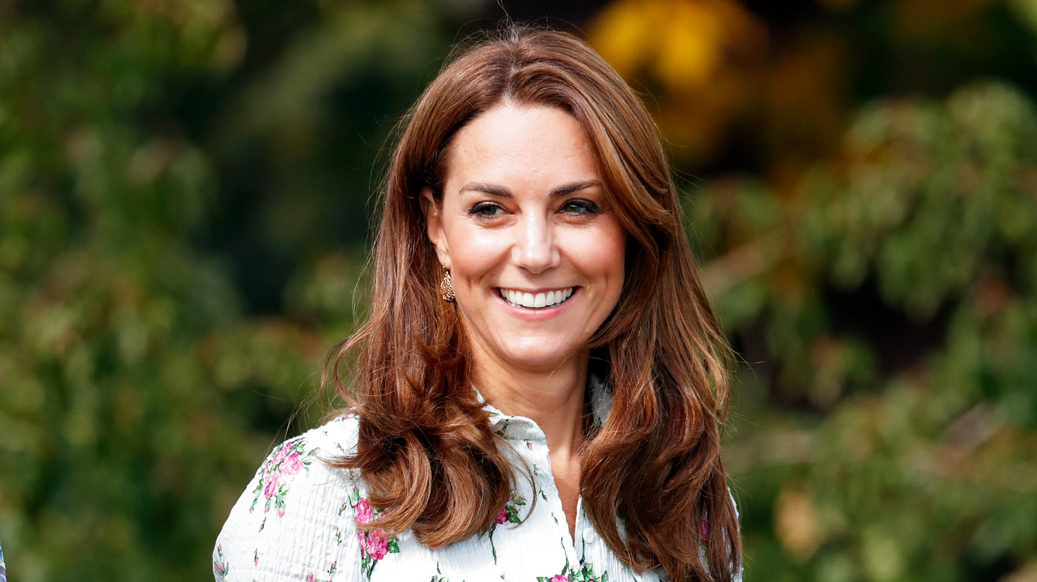

Slide 27

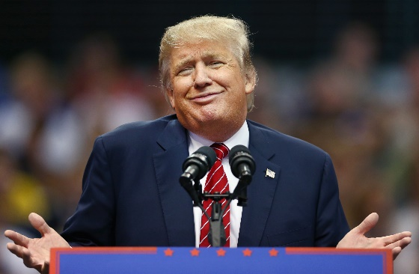




Who would you best like to be your leader?

Slide 28
What do you think?
Describe their faces - Stern, Soft ?
Who is the youngest
Who is the oldest
Who is the most attractive
How are they different
Should women be leaders of countries
Who is your favourite
Who has the most gentle face

Slide 29
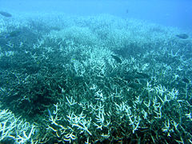
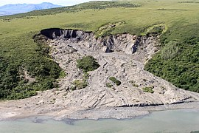
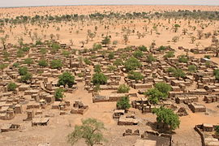
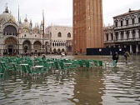
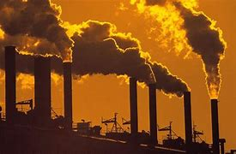
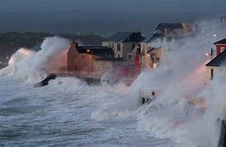
Global Warming/Climate Change

Slide 30
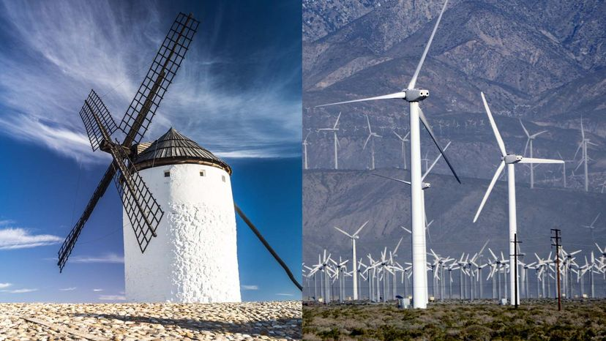
Renewable Energy

Slide 31


Renewable Energy

Slide 32

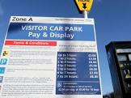
What do you Think
Should there be parking charges in your town?

Slide 33
What do you Think
Do you think increasing the price of cigarettes and alcohol will reduce the use?

Slide 34

Any Other Hot Topics??

Slide 35
Break Time

Slide 36
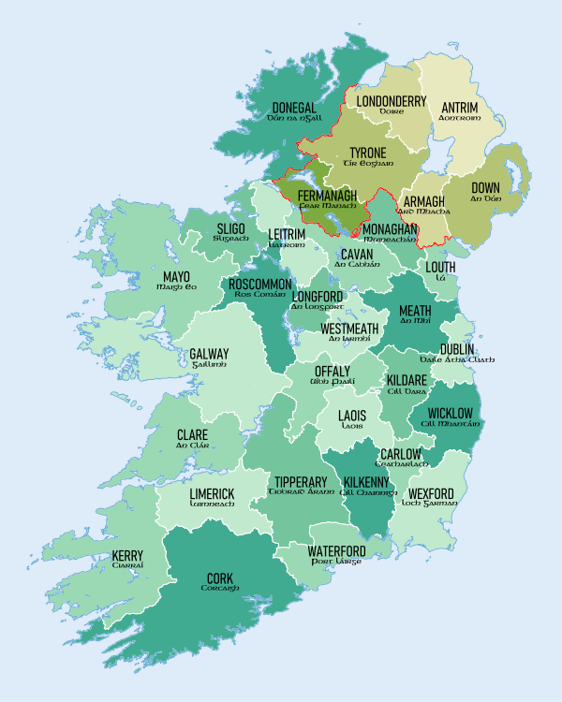
Scenes - Ireland

Slide 37
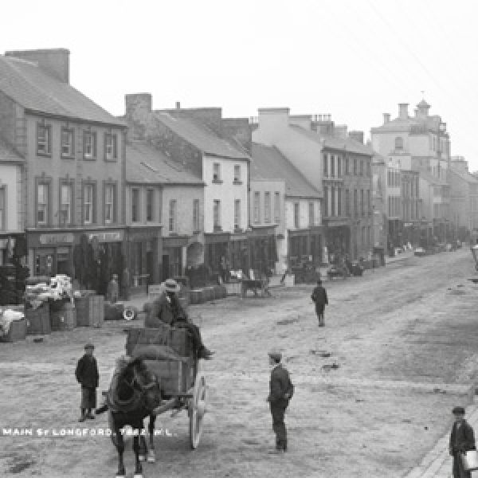
Do You Know Where it is?

Slide 38
Longford Main St

Slide 39
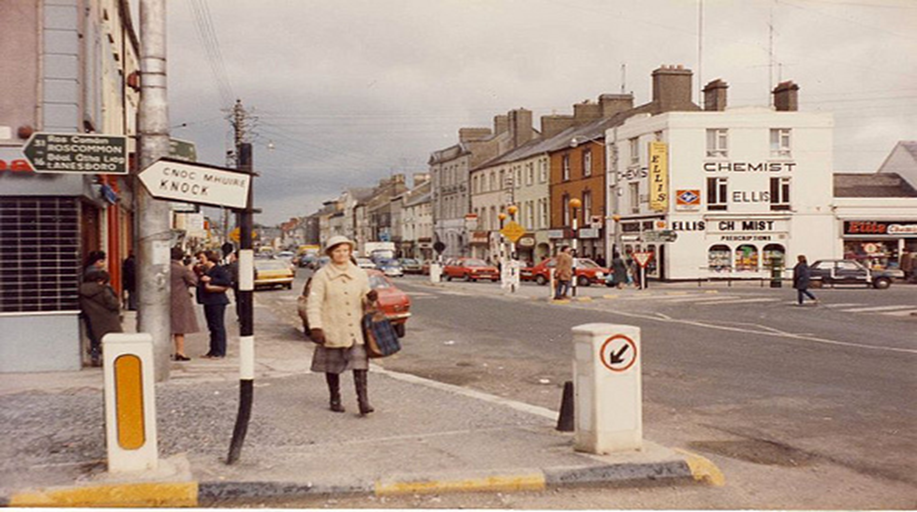

Slide 40
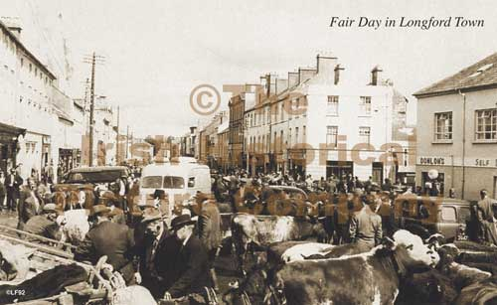

Slide 41
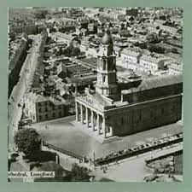

Slide 42
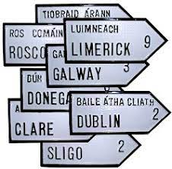
What Counties have you Visited

Slide 43
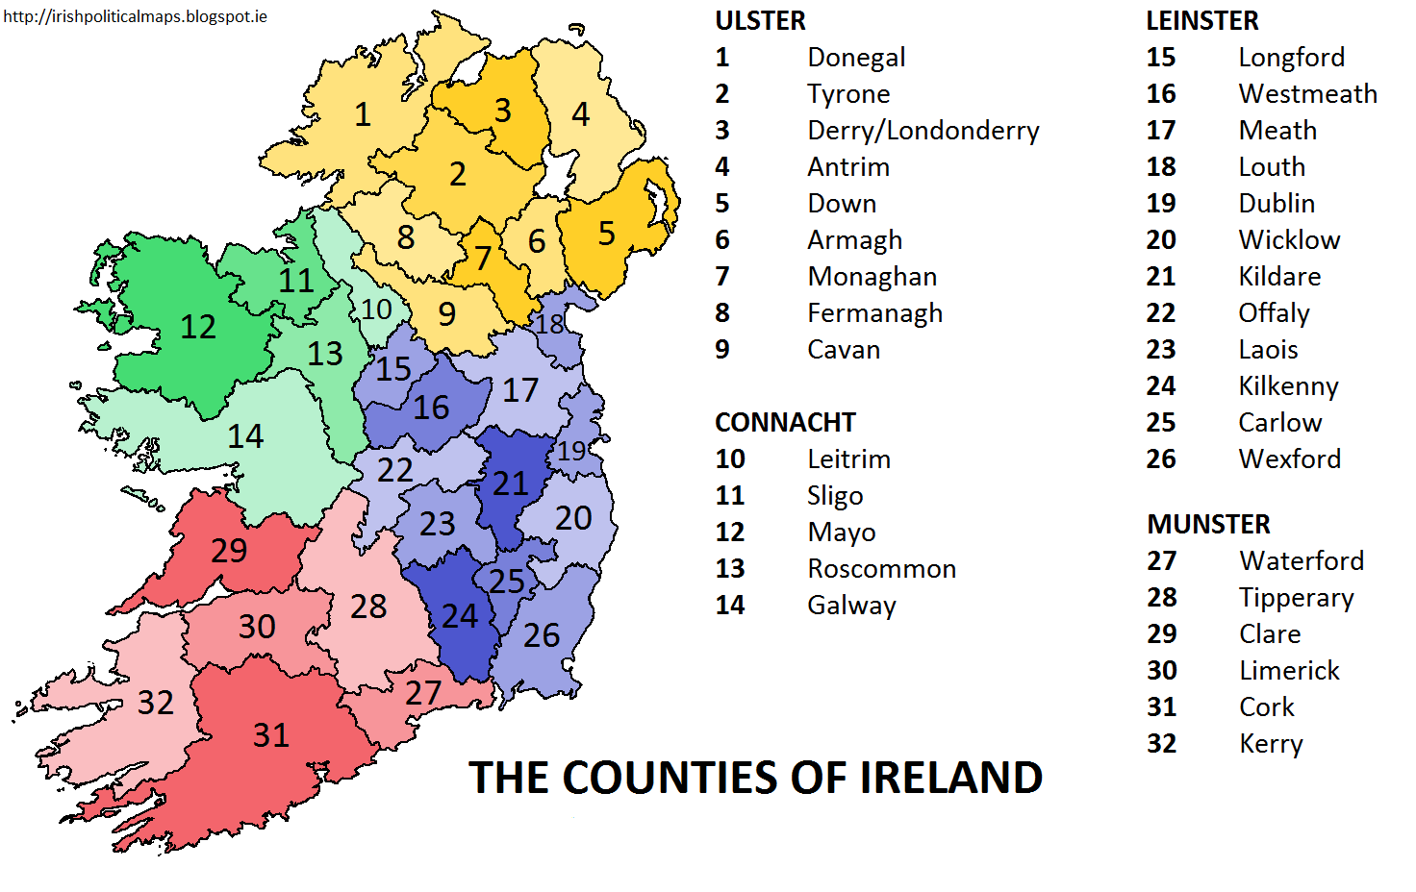
32 Counties

Slide 44
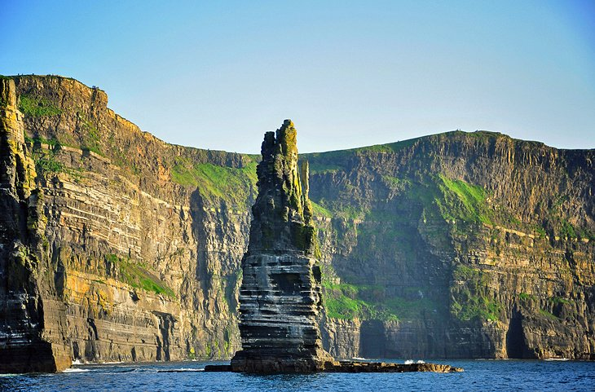

Slide 45
Cliffs of Moher

Slide 46
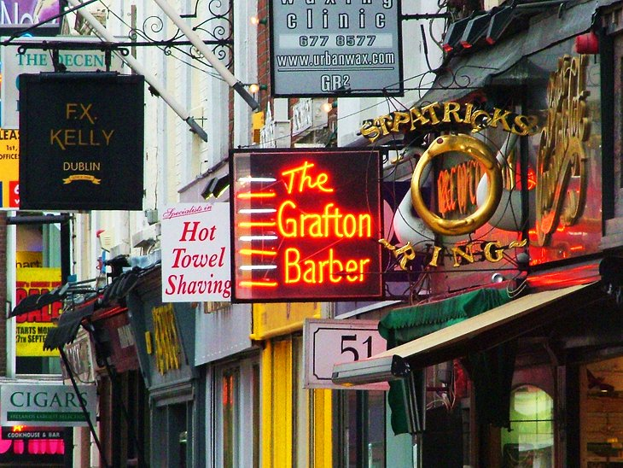

Slide 47
Grafton St , Dublin

Slide 48
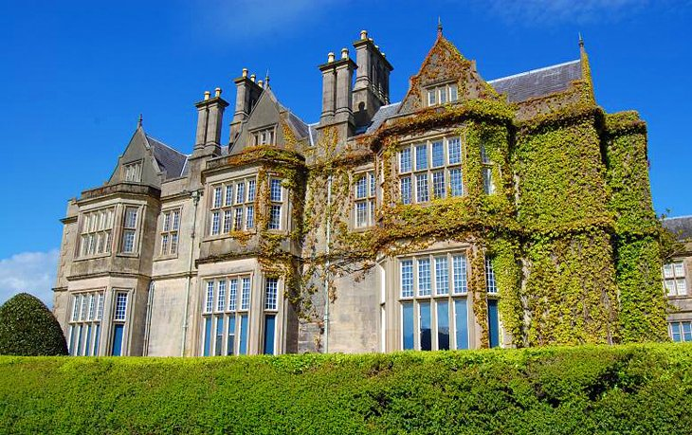

Slide 49
Killarney National Park and Muckross House

Slide 50
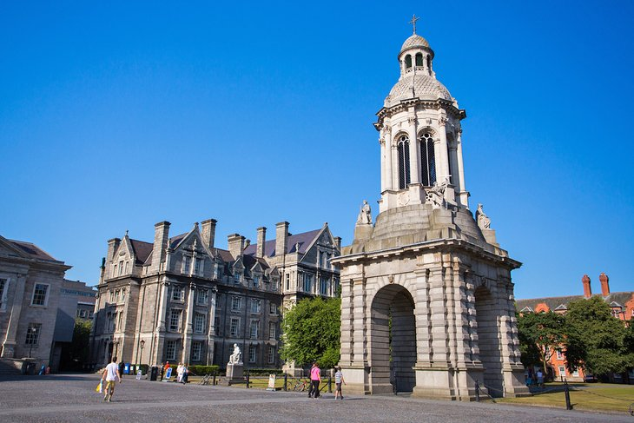

Slide 51
Trinity College

Slide 52
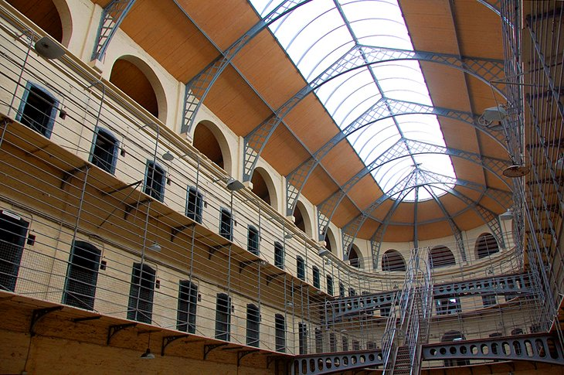

Slide 53
Kilmainham Jail

Slide 54
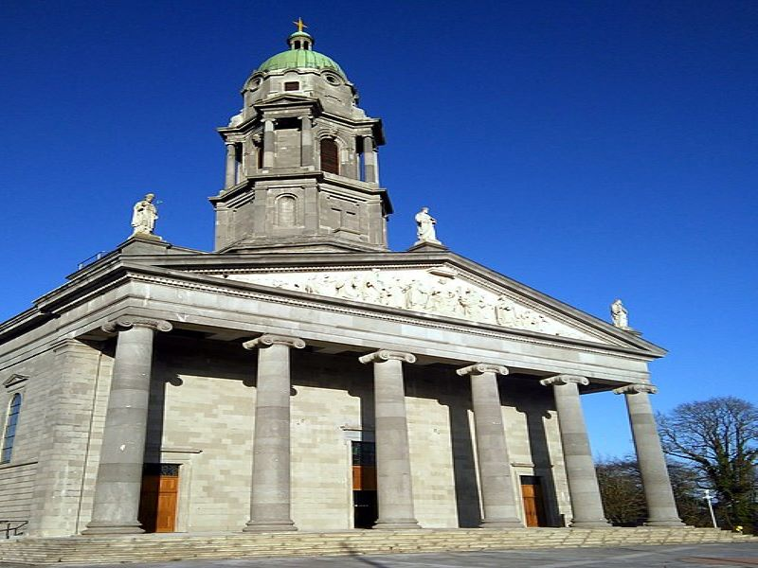

Slide 55
Longford Cathedral

Slide 56
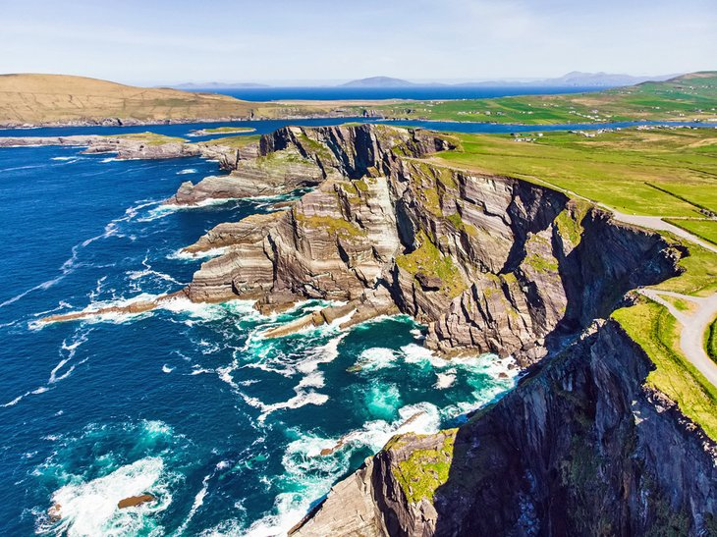

Slide 57
The Ring of Kerry/Kerry Cliffs

Slide 58
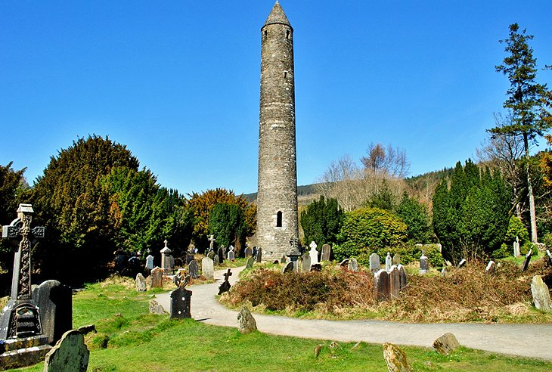

Slide 59
Roundstone , Glendalough

Slide 60
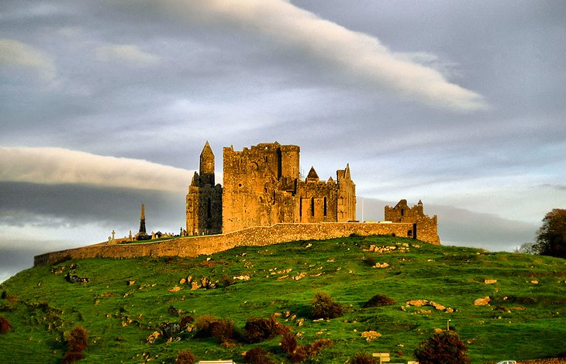

Slide 61
The Rock Of Cashel

Slide 62
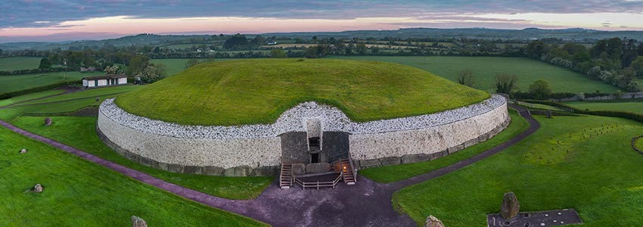

Slide 63
New Grange
Co Meath

Slide 64
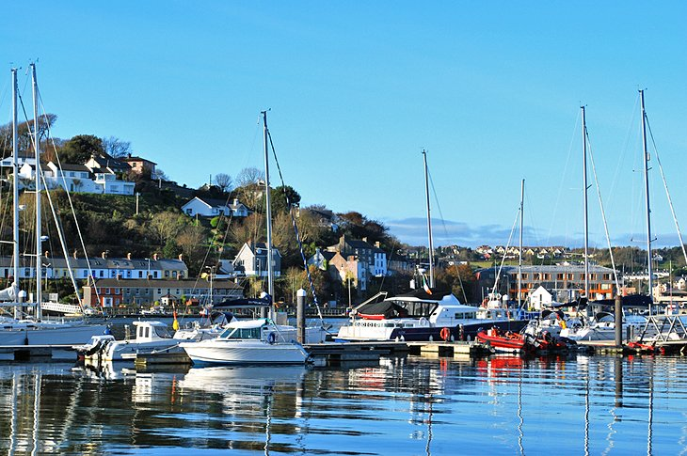

Slide 65
Kinsale , Co Cork

Slide 66
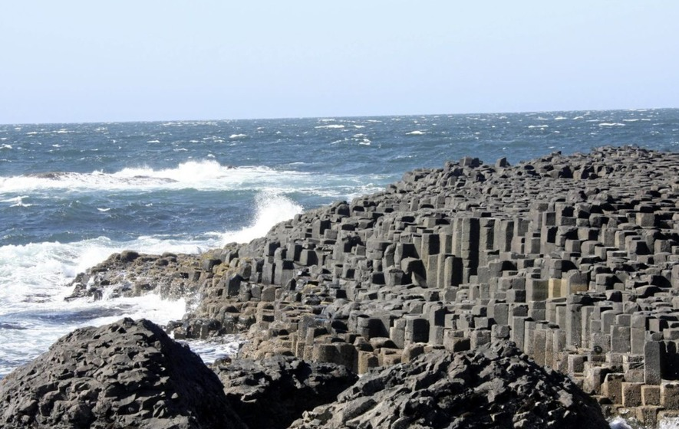

Slide 67
The Giants Causeway

Slide 68
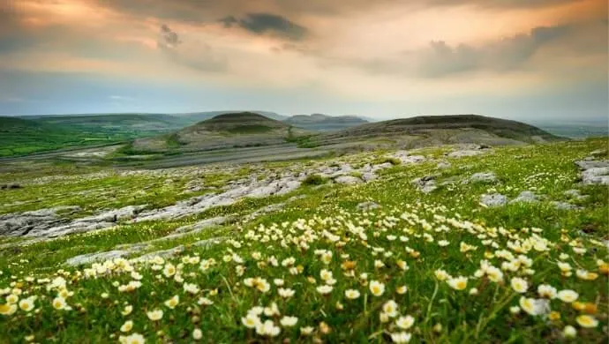

Slide 69
The Burren , Co Clare

Slide 70

Where is your favourite place in Ireland

Slide 71
The Waterford ………

Slide 72
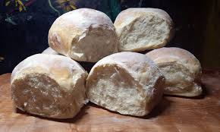
The Waterford - Blaa

Slide 73
Leitrim/Cavan/Fermanagh

Slide 74
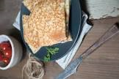
Boxty

Slide 75
Dublin ..

Slide 76
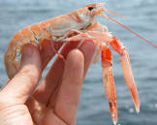
Dublin Bay Prawns

Slide 77
Galway…
.

Slide 78
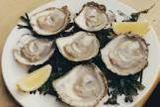
Oysters

Slide 79
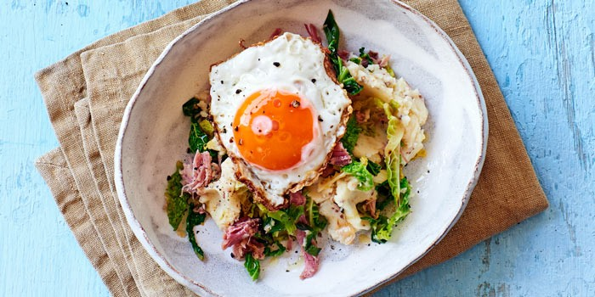
What’s in it??
Colcannon and champ

Slide 80
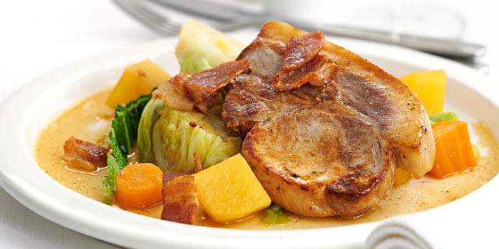
Coddle

Slide 81
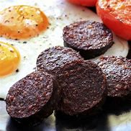
Black and White Pudding

Slide 82
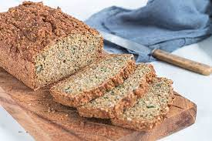
Ingredients to make a Brown bread……

Slide 83
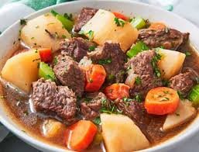
Ingredients to make an Irish Stew

Slide 84
Group Song

Slide 85

Goodbye – See you next week!

